Slide 1
Programme 4
Mickey Ma (马毓琦): mickeyma@cuhk.edu.cn
Office: Teaching C Building Room 501(TC-501)
Phone: 0755-23519635
WeChat: my_qiqi
Office Hours: TUE 16:00-17:00
FRI 16:00-17:00

Slide 2
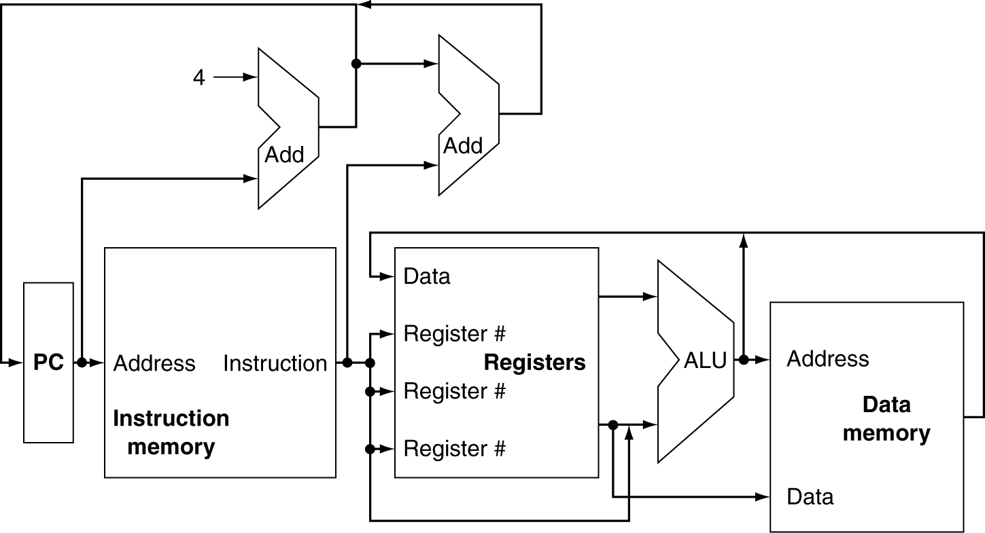
Datapath

Slide 3
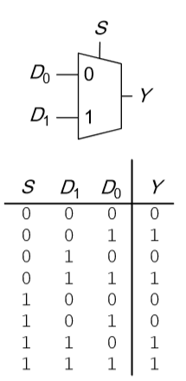
Datapath
Multiplexers

Slide 4
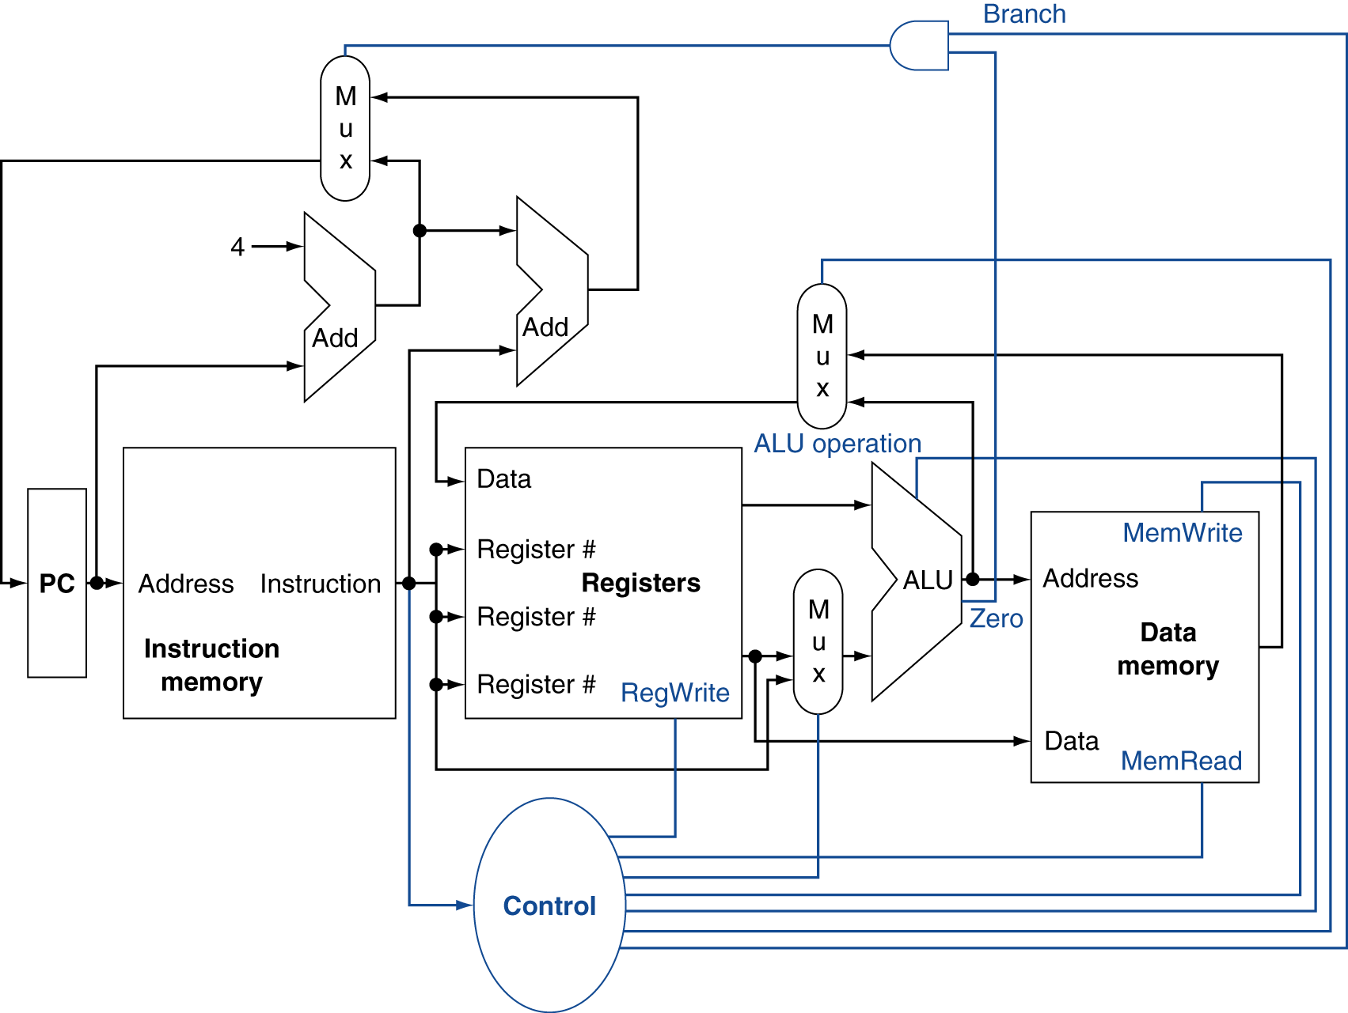
Datapath

Slide 5
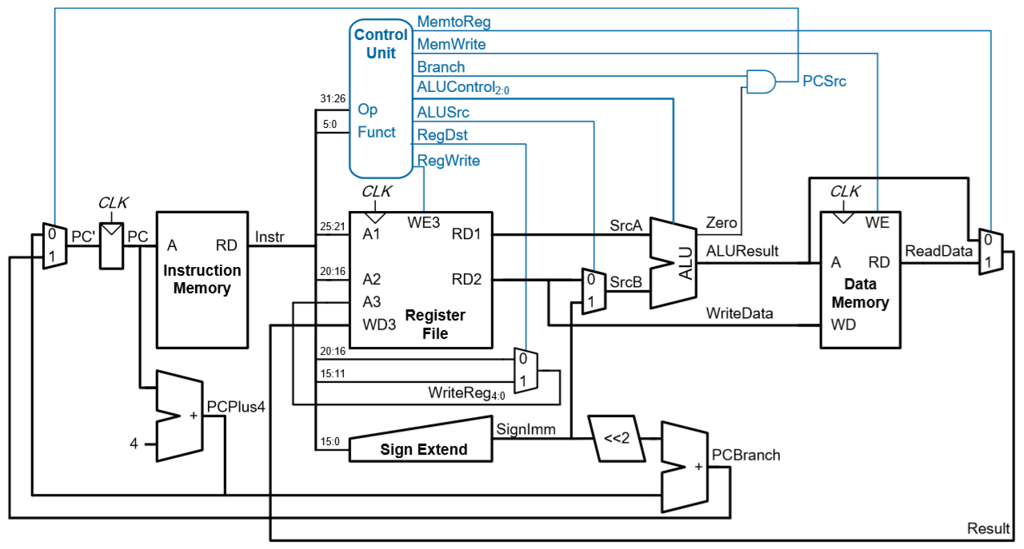
Single-cycle MIPS Processor

Slide 6
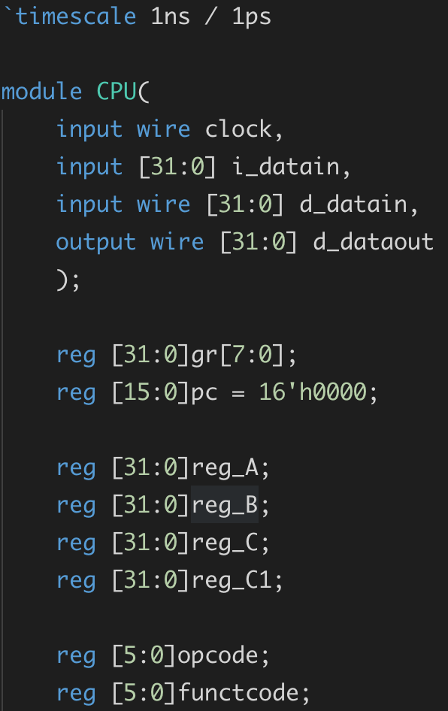
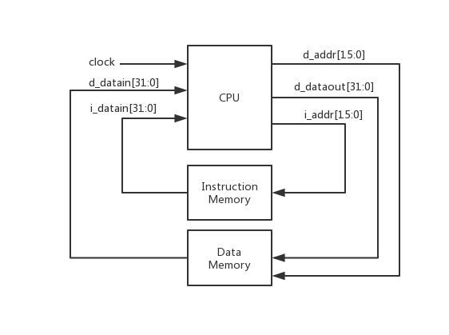
Top View
CPU.v

Slide 7
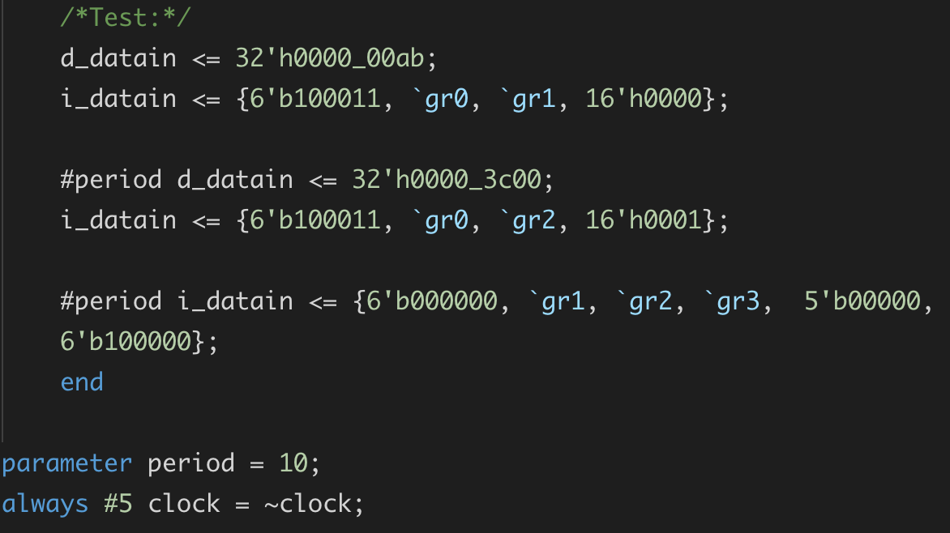
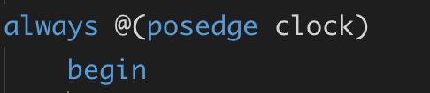
Clock
test_CPU.v:
CPU.v:

Slide 8
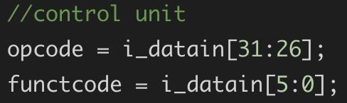
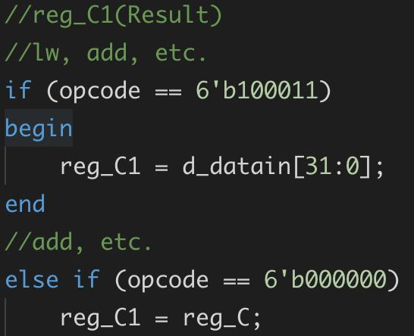
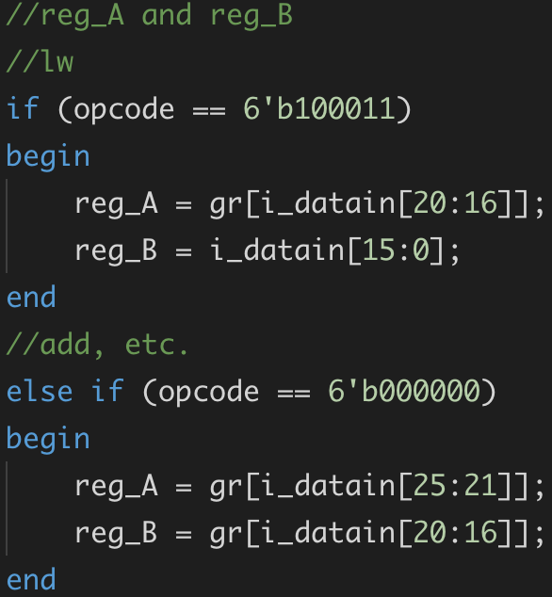
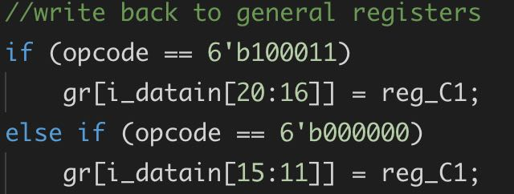
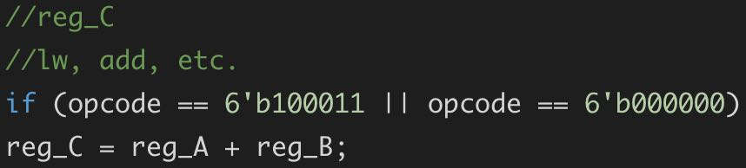

Main code
CPU.v:

Slide 9
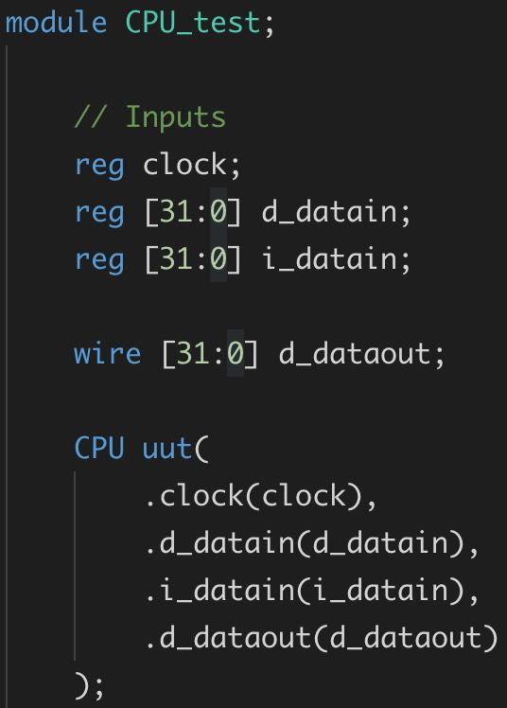
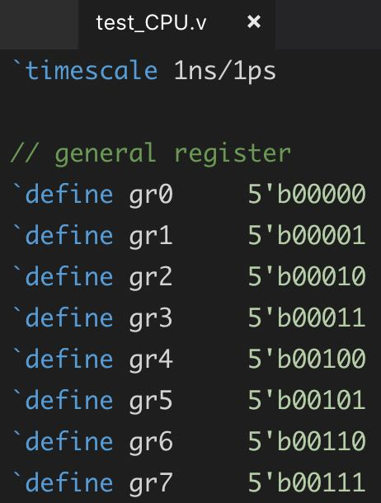
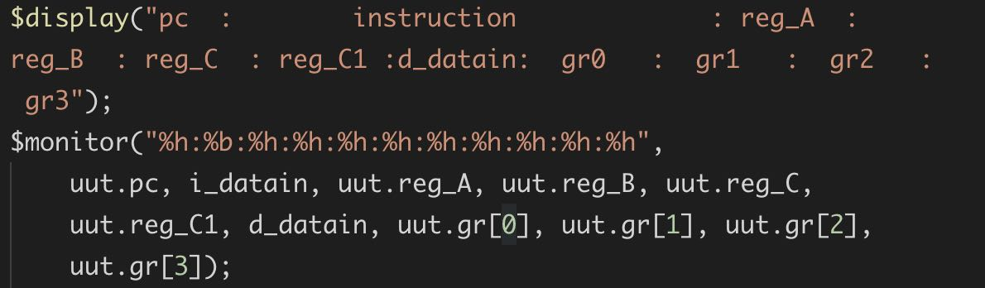
Main code
test_CPU.v:

Slide 10
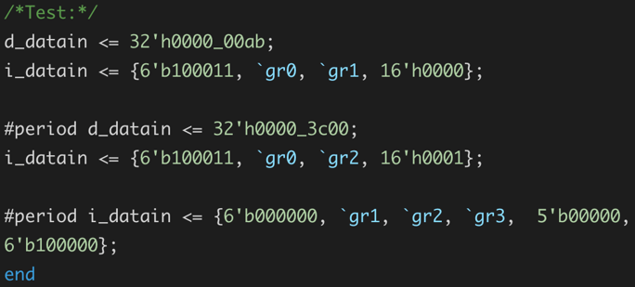
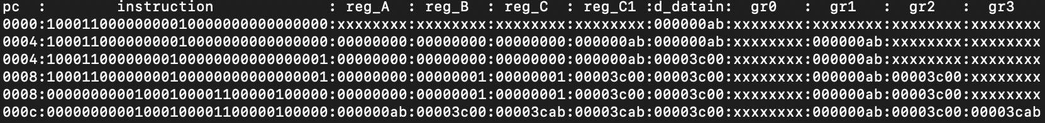
Result

Slide 11
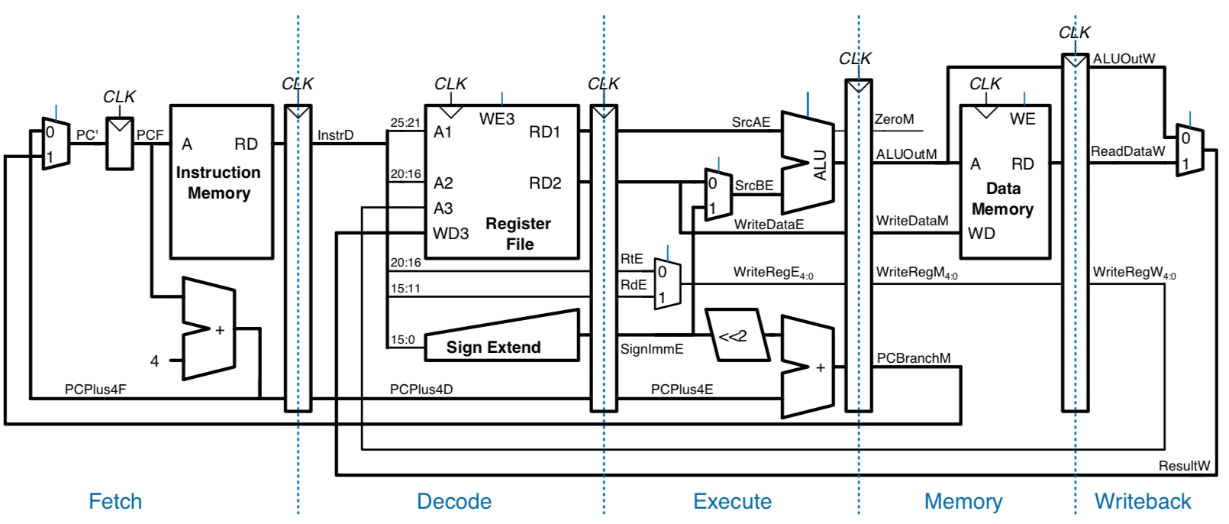
Pipelined Datapath

Slide 12
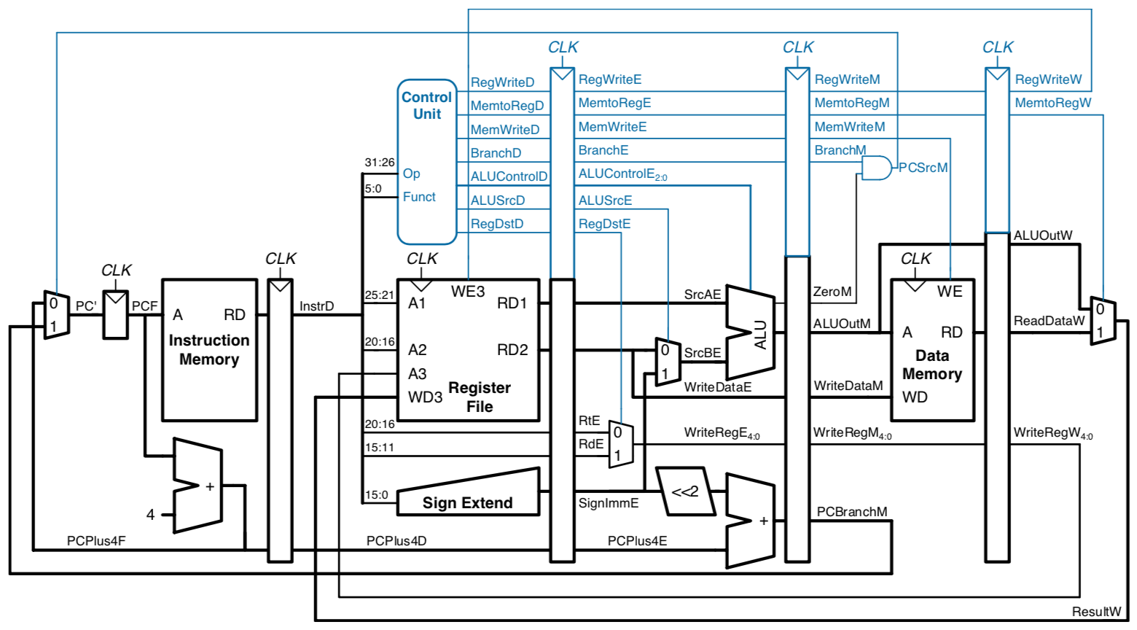
Pipelined Processor with Control

Slide 13
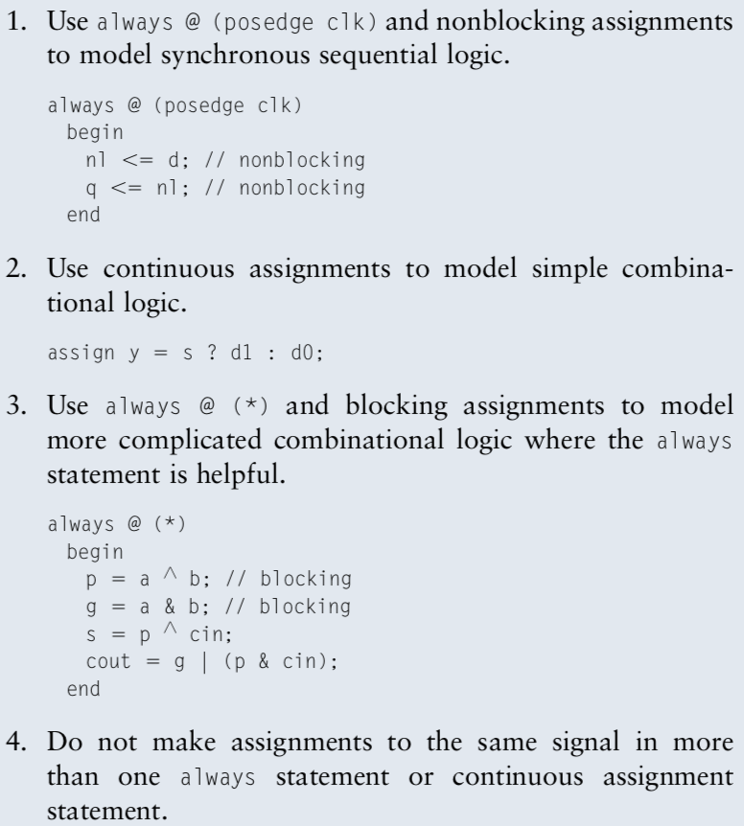
Blocking and non-blocking assignments
Example:
a = 1; b = 2; c = 0;
1.
always @ (*)
begin
b <= a;
c <= b;
end
end
//We will get b = 1, c = 2
2.
always @ (*)
begin
b = a;
c = b;
end
end
//We will get b = 1, c = 1

Slide 14
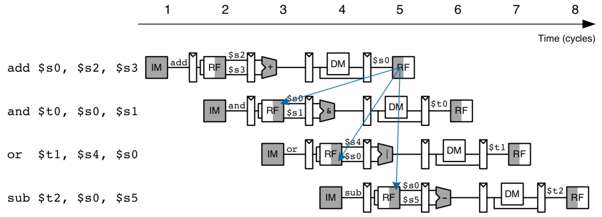
Hazards

